Slide 1
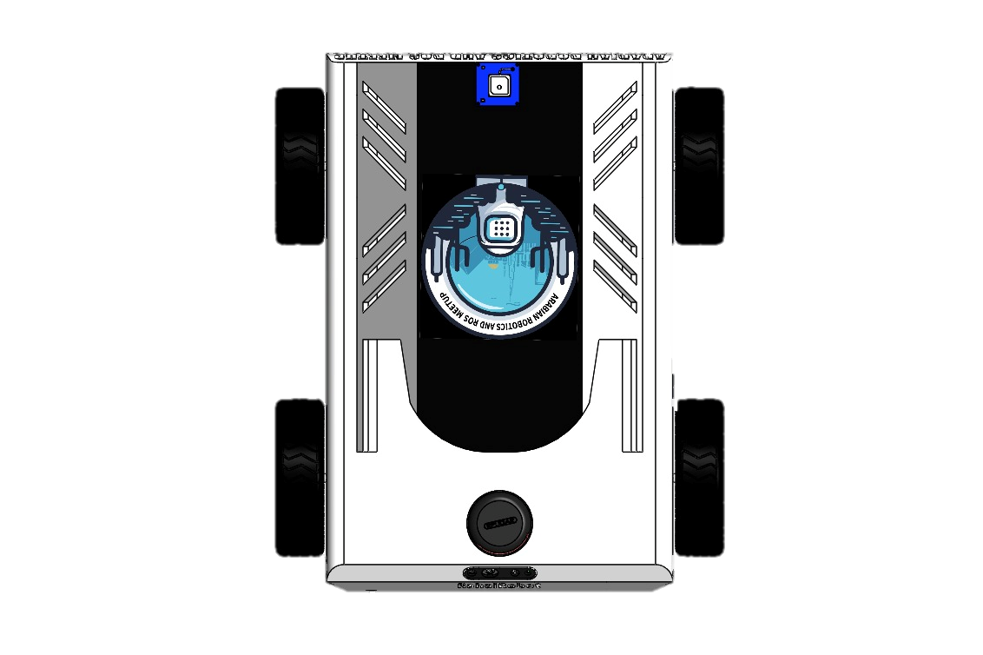

Slide 48

After Multiple Loop Closure

